Slide 1
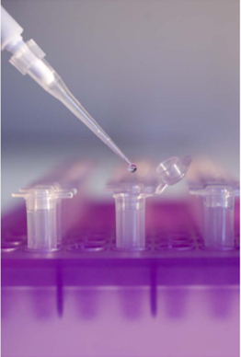
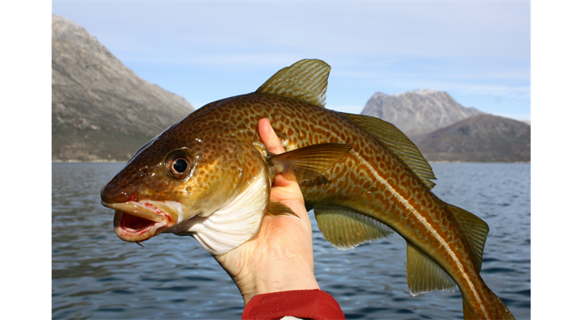
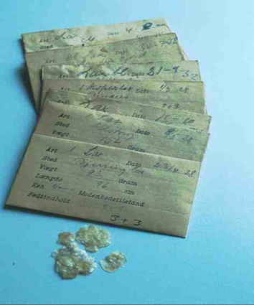
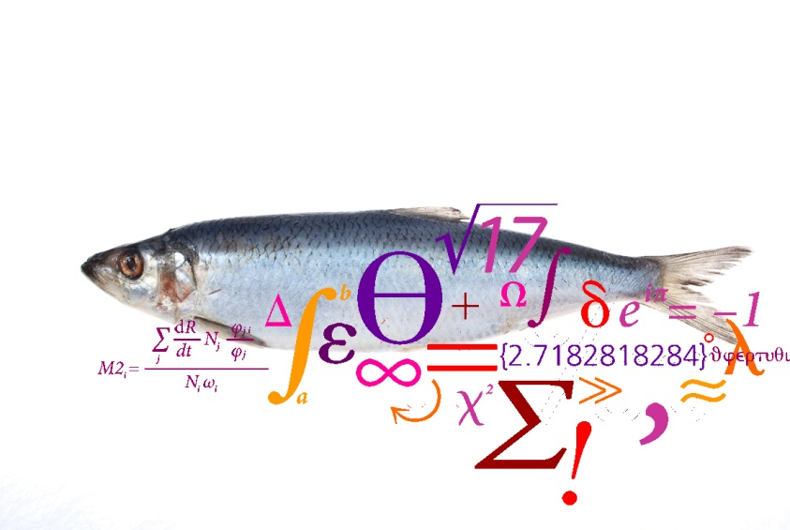
- Case studies
Einar Eg Nielsen DTU-Aqua Denmark

Slide 2
Starting point
“The regulation identifies 250+ stocks along the European EEZ for which length frequencies and other biological information must be collected, and mentions another unknown number of species, the by-catch and/or discarded species, for which similar information must be collected”
“How to take into account distinct spatial and temporal scales?”
What is a population?
How many biological populations are there?
How do they contribute to fisheries?

Slide 3
What constitutes a population?
Ne
Ecological:
migration rate < 0.1
Evolutionary (genetic):
Number of migrants (N_{e}m)< 25
Example: N_{e} = 250; m = 0.1
Ne
m
m
m
m
Ne
Ne
Waples and Gaggiotti 2006

Slide 4
“Stamp collection” or important?
Genetic differentiation signals low migration among populations/areas
ICES Square
3
2
1

Slide 5
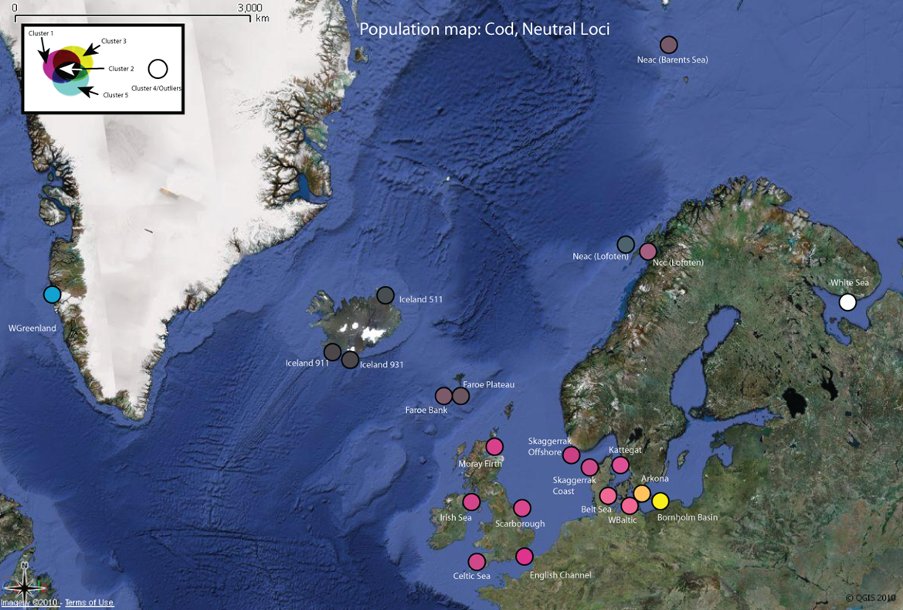
Traditional genetic tools“Neutral genes” – affected only by random genetic drift and migration

Slide 6
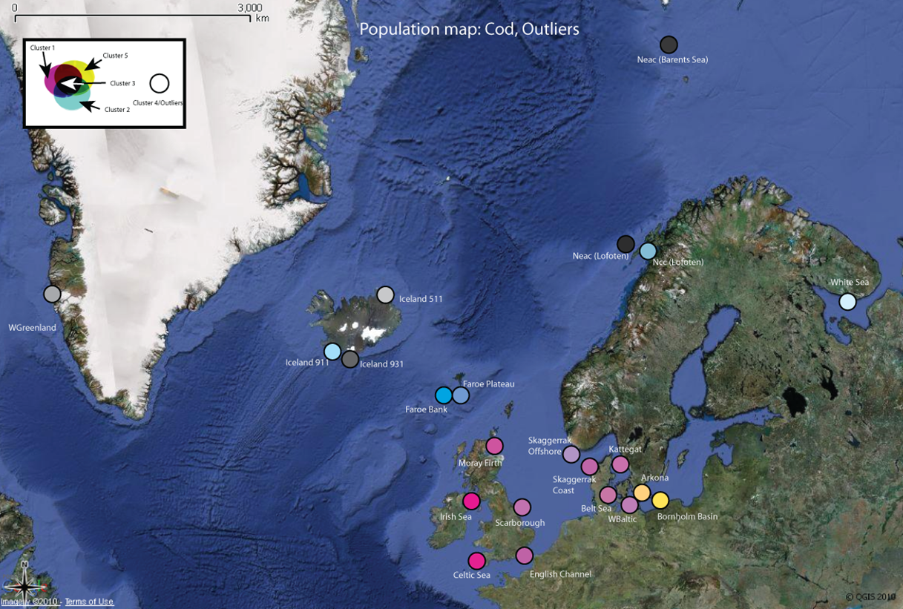
New tools: Genes affected by (environmental) selection

Slide 7
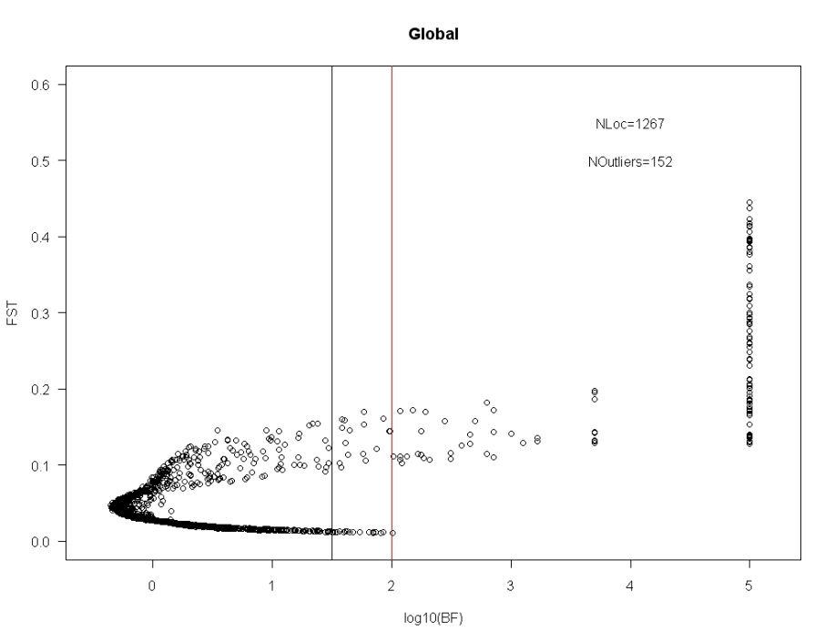
Why is it so?
A genome scan!
Power for identification of origin

Slide 8
Identification of population units
“FishPopTrace”: Traceability of fish populations EU7FP
Cod, herring, sole and hake
281 – 1262 SNPs (single nucleotide polymorphisms) in genes
4 policy driven cases studies related to IUU fishing and potential mislabeling
Nielsen et al. submitted

Slide 9
Minimum SNP panels with maximum power
Cod: 8 SNPs
Herring:32 SNPs
Sole: 50 SNPs
Hake: 17 SNPs

Slide 10
Importance for North Sea cod
Three units identified by SNP analysis
Spatial modelling (by MASTS group) suggest that the north-eastern North Sea population is less productive and more vulnerable to fishing
Continued fishing at overall sustainable intensities in the North Sea, without taking population structure into account, is likely to lead to unintended depletion of the north-eastern population
Spatial considerations must be incorporated into fisheries management, if conservation of population diversity is to be achieved
Heath et al. submitted. Natural Environment Research Council (NERC) Sustainable Marine Bioresources Programme

Slide 11
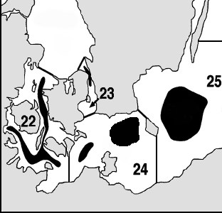
Western Baltic cod in space and time
The Commission has requested advice from STECF. A lower TAC is expected unless a more realistic estimate of Fmsy of individual populations can be achieved. So, where do the fished cod originate from?
EFF funded project: Sampling of biological (spawning) units. With only 20 markers (SNPs) individuals can be assigned unambiguously to sea area of origin. Analysis will be applied to historical samples
?

Slide 12
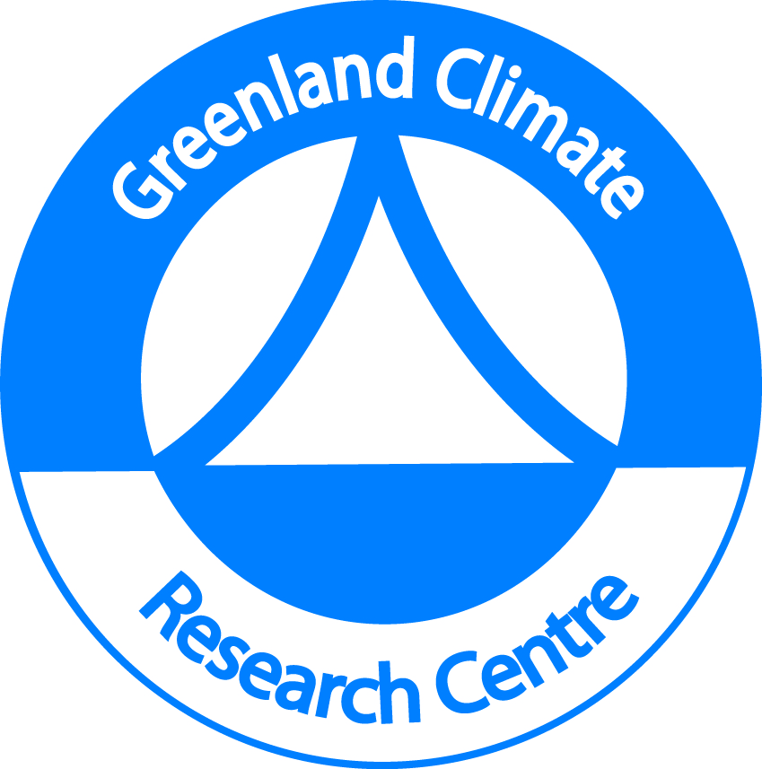
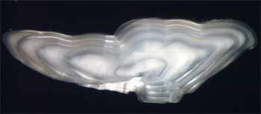
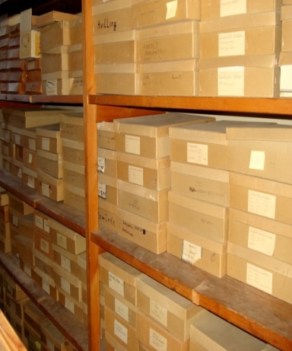
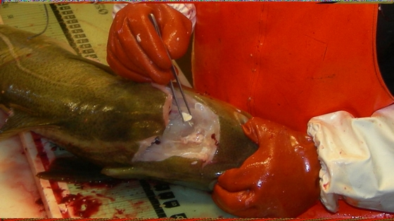
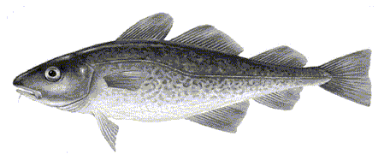
“The Atlantic cod in Greenlandic waters; past and future under climate change”
Aim:
To apply genetic and chemical analysis to unique collections of historical otoliths (100 years) to assess, understand and predict spatial and temporal population dynamics of Atlantic cod in Greenlandic waters in response to climate change
Notes:
Moderne DNA teknikker har gennemgået en voldsom udvikling gennem de sidste 10 år og anvendes nu til at besvare en lang række spørgsmål indenfor fiskeri og ressourceforvaltning.
Øresten er små kalkstrukturer, som sidder i væskefyldte kanaler inde i hovedet på fisk. De spiller højst sandsynlig en vigtig rolle for fiskens hørelse og balance.
Ved udtagningen af øresten (se billede) aflejres der indtørret væv på den, hvilket kan bruges til DNA analyser selv efter meget lang tids opbevaring. Selve ørestenen kan ved kemiske analyser afsløre hvad torsken har spist. Således vil den kemiske signatur være forskellig om torsken har spist fisk eller rejer.

Slide 13
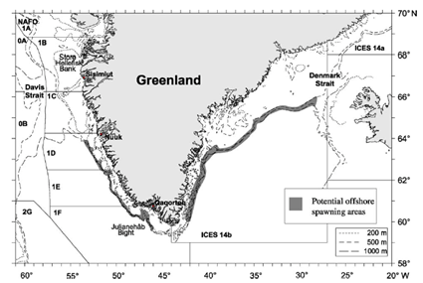
Questions to be answered
How many populations?
Importance of Icelandic cod?
Are populations specifically adapted to local conditions?
What is the importance of different populations for cod fishing in Greenland?
What causes the large changes in abundance and distribution (population based modelling)?
Where will the cod be in 10-30-50-100 years – and how many are there?
?
?
?
Notes:
Man ved ikke om torsken ved Grønland udgøres af én samlet bestand, eller om den består af en række underbestande. Generelt har man tre hypoteser om hvor de stammer fra: Lokale fjordbestande, offshore bestande på bankerne ud for kysten, samt indstrømning af æg og larver fra store bestande ved Island. De genetiske analyser kan så afsløre om torskene har forskellig genetisk signatur afhængigt af hvor de lever – eller om de alle er skyllet ind fra Island og derfor har den samme genetiske sammensætning. Man mener at de store udsving man ser i fiskeriet direkte skyldes indskyl af islandske torsk.
Ved at forstå de historiske sammenhænge mellem klima og torskenes udbredelse og antal vil vi modellere fremtidens udbredelse og talrighed af torsk i Grønlandske farvande – og hvilken betydning det har på hvor, hvornår og hvor mange torsk man kan fange.

Slide 14
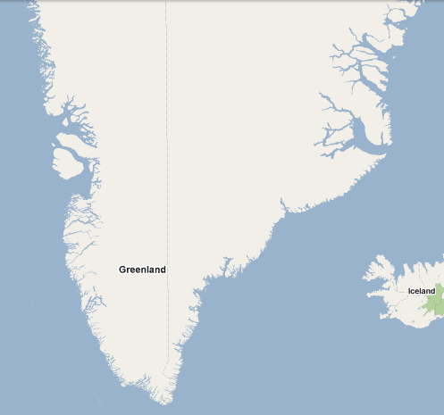
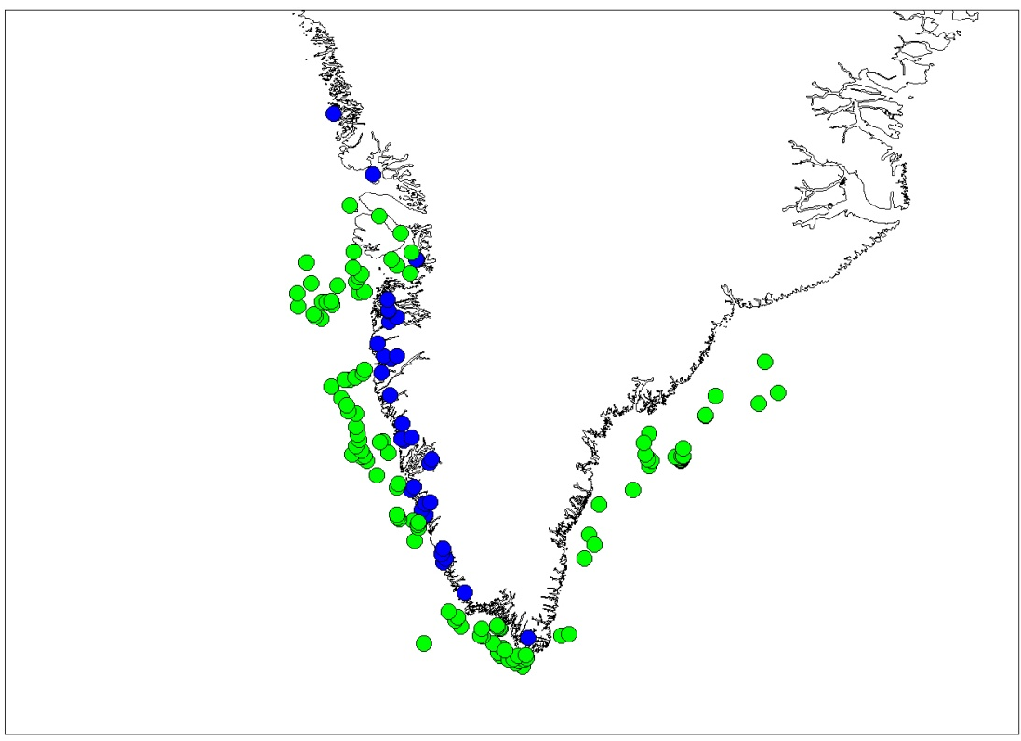
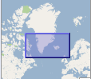
Spawning population samples App. 30 individuals genotyped for 1152 SNPs in each sample
Legend
Uummannaq 1937, 2010
Inshore sample (area and years)
Offshore sample (area and years)
Illulissat 1952,2010
Store Hellefiskebanke 1950
Paamiut samples
2010: 41 ind spread out
Sisimiut/Sarfannguit 1931, 2010
IS511 2002
Lille Hellefiskebanke 1955
Tasiilaq 2010
Fylla’s Bank
1954
Nuuk
Ameralik: 1937, 2008
Kapisillit: 1940, 2008
Qorqut: 2008
Offshore 2010
IS911 2002
IS931 2002
Dana’s Bank
1934, 2008
Paamiut 1909, 2008
Gulf of St Lawrence 2008
Qaqortoq 1947, 2008
Offshore 2010
Notes:
Ved at bruge historiske prøver, kan både se hvor stabil strukturen er og se om nogle gener har været under selektion

Slide 15
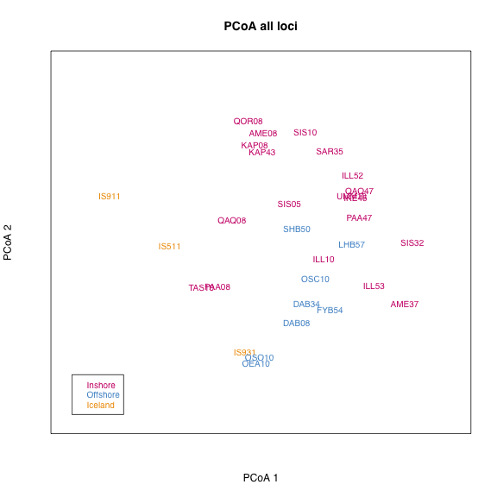
Notes:
En metode til at repræsentere parvise forskelle mellem prøver
Baseret på alle markører

Slide 16
Status for “Greenland cod”
Several local Greenlandic spawning components are apparent and appear to be locally adapted
Population structure in some areas have been dynamic others more stabile
Estimation of the spatiotemporal contribution of various stock components to fisheries is possible and in progress
Predictions of cod (population) distributions in the sea based on models using abiotic variables and previous cod surveys appear very promising

Slide 17
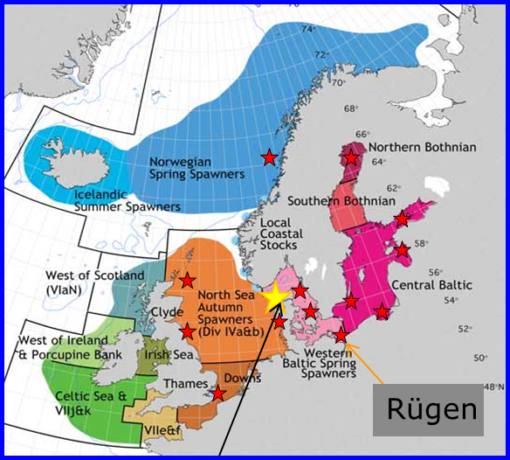
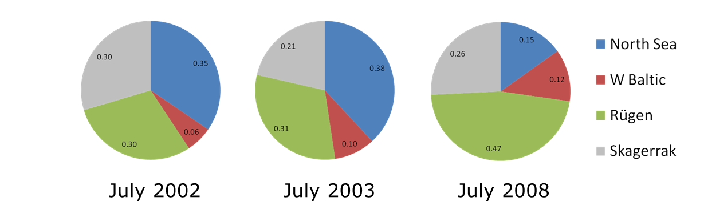
Bio-complexity in herring
Skagerrak is an important feeding area for North Sea and Western Baltic herring
Traditional stock identification methods only separates NS from WB
Ca. half of ”WB spring-spawners” in mixed feeding samples are not from Rügen, which is the only spawning population assessed
Bekkevold et al in press

Slide 18
Plaice in IIIa
The assessment of plaice in Skagerrak has been rejected since 2005, due to high variability in both fishing mortality (F) and spawning stock biomass (SSB)
The current stock definition in the ICES division IIIa is not suitable for management of plaice fisheries in the area
Genetic (and ecological) studies may enable assessment of spatial and temporal variation in contribution from various populations
NS contribution
Cardinale et al. 2011

Slide 19
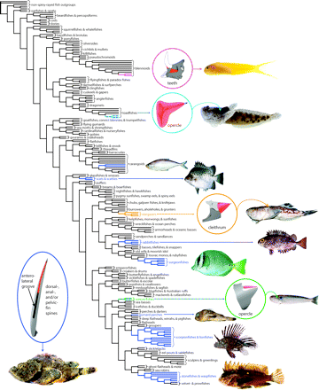
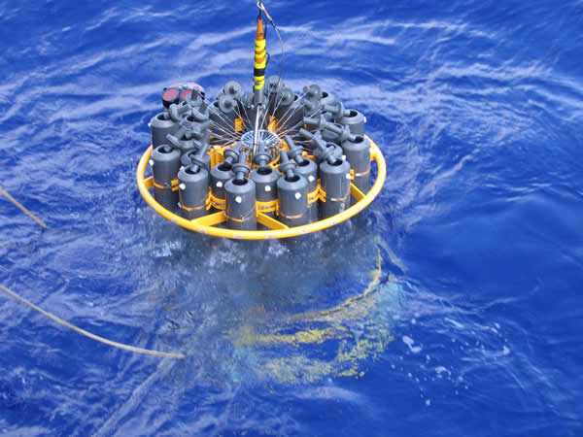
Metagenomics
Assessment of fish (marine) biodiversity from water samples – focus on key species in restricted areas
Assessment of plankton diversity from “ground” plankton hauls
Assessment of feed composition from fish stomach fluids
Next-gen sequencing of gene(s) COI

Slide 20
Conclusions
Data collection with limited knowledge of biological population structure, migration and contribution to “mixed-stock fisheries” make assessment and long term prediction very difficult
Genetics/genomics can contribute in many ways to improve short term assessment and long term management
Costs of routine DNA testing is relatively low (<15€ per individual)
More integrative projects with genetics/genomics and cutting edge fish ecology (e.g. DST tagging and chemical methods) are needed
More collaboration between geneticists and spatiotemporal -/fisheries modellers is highly warranted
Metagenomics is likely to change the way we monitor marine diversity today

Slide 21
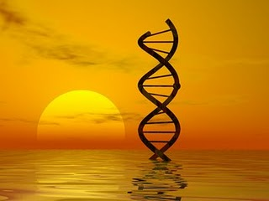
Thank you!

